Slide 1
CudaDMA: Optimizing GPU Memory Bandwidth via Warp Specialization
Jiaqi Huang and Yiheng Du

Slide 2
General Overview
Problem:
GPU apps are increasingly memory-bandwidth limited
Key Idea:
DMA warps move data (On chip and off-chip)
Compute warps do computation
Benefits:
Better Memory Bandwidth Utilization
with Memory Level Parallelism and efficient producer-consumer synchronization
Better programmability
Results:
1.37x microbenchmark
1.15x–3.2x application kernels

Slide 3
Background
Around 2011, GPU widely used in large-scale supercomputers
Programmers need to achieve peak performance with algorithms
Balance between computational intensity and memory bandwidth
Each thread is responsible for both things
Well for the same shape of the data transferred with thread hierachy
Hardware level of decoupling existed (DMA Engine)

Slide 4
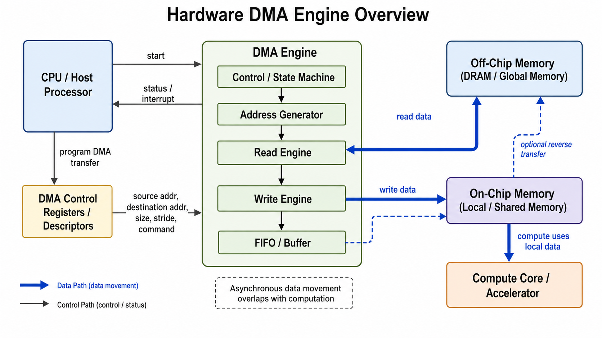
Proposed Solution
Software Level Solution:
CudaDMA, extensible API
Decouple the size and dimensionality of the data from those of computation
Better Programmability
Better Performance

Slide 5
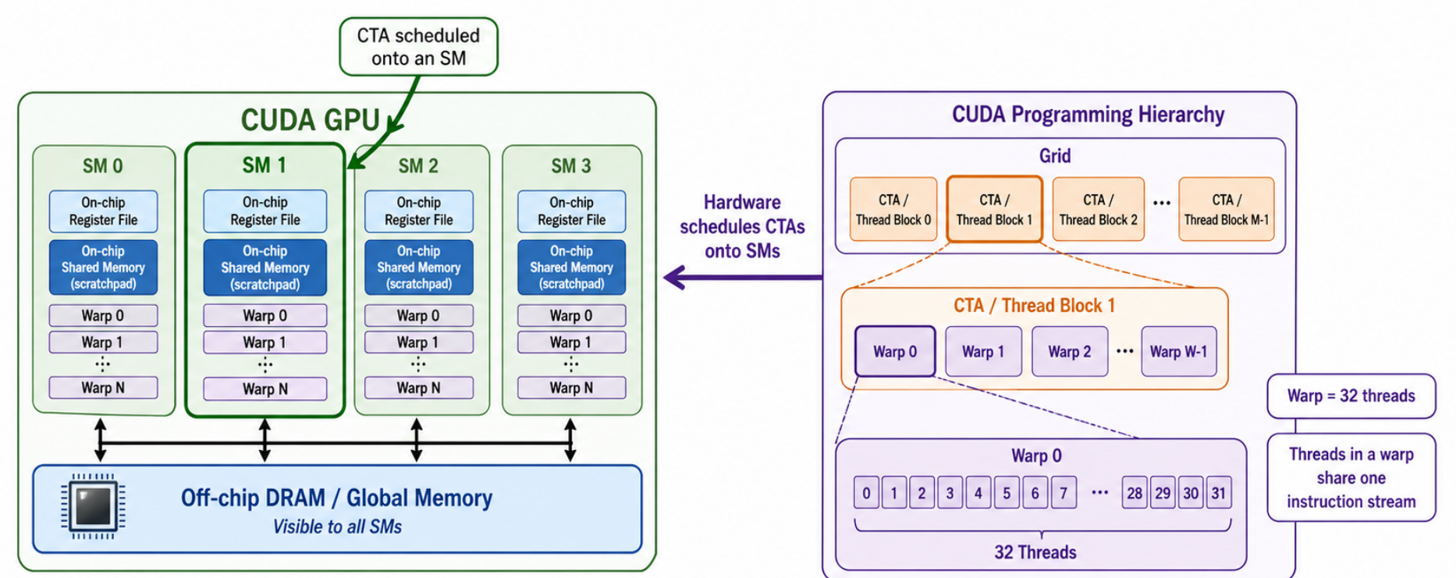
CUDA is a general purpose programming language for programming GPUs
streaming multiprocessors (SMs) + cooperative thread arrays (CTAs)
Control divergen ce within a warp hurts, inter warps does not

Slide 6
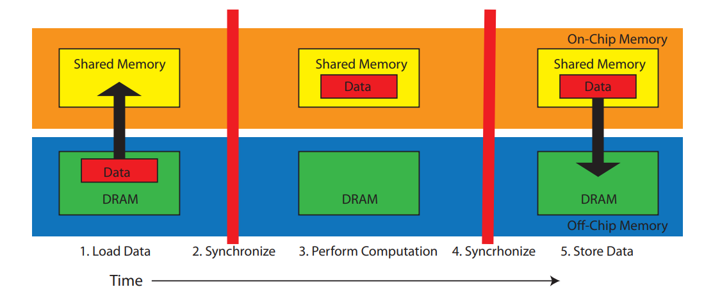
Synchronization
Encourage first moves to on-chip memories
Computer
Write back
Lightweight barrier to synchronize

Slide 7
Challenge
Programmability: Tend to choose the CTA size and dimensions of the computation
When data accessed is different
Hard to write code and maintain code
E.g. Stencil Algorithm: CTA based on output, not data transferred

Slide 8
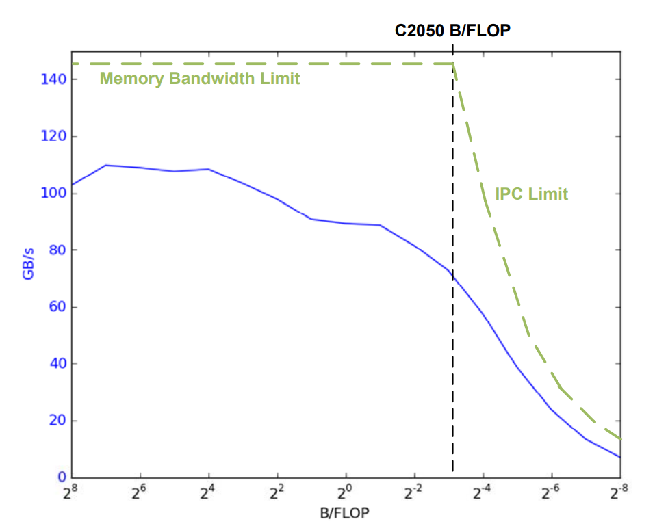
Challenge
Performance:
Low Compute-to-Memory Ratio:
Low reuse, Saturate BW
High Ratio:
High reuse, limited by IPC
Hardware level limitations
Load/Store Loop, 3 First Step
2KB from DRAM, 14 SM, 28 CTAs,

Slide 9
75% of the 144 GB/s peak BW
(Pratical Limit 85%)
Limited by IPC
Balanced area: 0.14 B/FLOP
50% of peak BW

Slide 10
Limitations of CUDA
Computational Bottleneck
Many long-latency memory accesses: A warp stalls
Coarse-grained synchronization: Warps need to wait for other warps
Data Access Patterns: Different data patterns lead to intra-warp divergence and bank conflicts in accessing shared memory

Slide 11
Limitations of CUDA
Memory Bottleneck
Issuing multiple memory accesses simultaneously and allowing the memory system to handle them in parallel is referred to as Memory Level Parallelism (MLP).
Two factors impede MLP:
Instruction Issue: A warp is stalled
Data Access Patterns: Data pattern different from CTA prevent memory coalescing

Slide 12
Limitations of CUDA
Compute and memory access is coupled
A warp handles both things
Programmers write logic to coordinate two things
Bottlenecks are entangled

Slide 13
CUDADMA API
Warp sepecialization: Perform at warp level
DMA Warps + Compute Warps

Slide 14
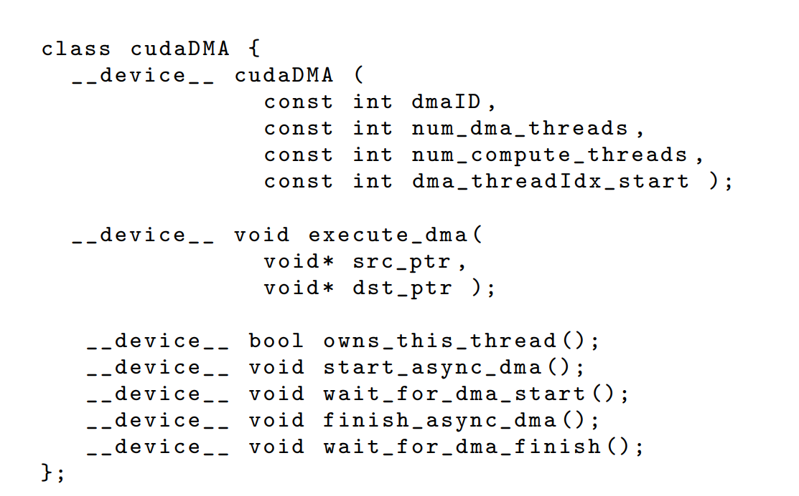
CUDADMA API
Object Based for a shared memory buffer
Provides synchronization methods

Slide 15
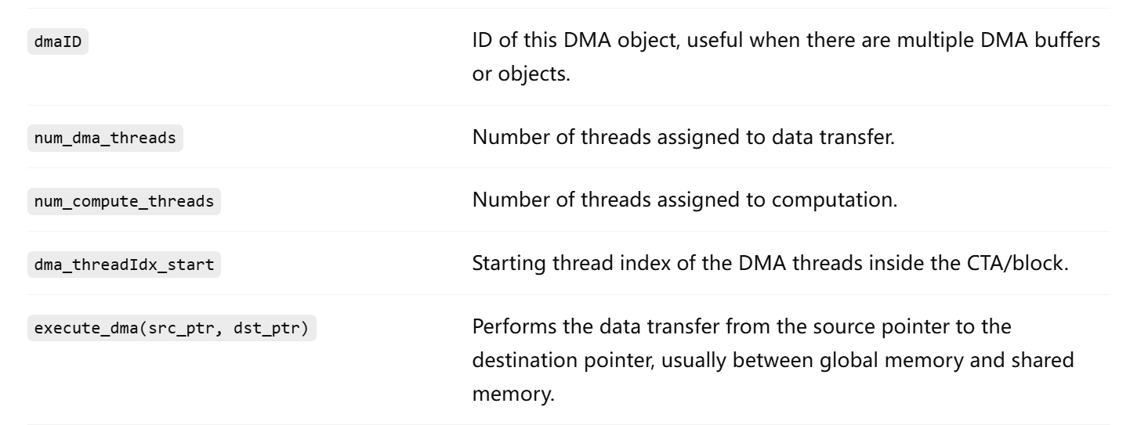
CUDADMA API

Slide 16
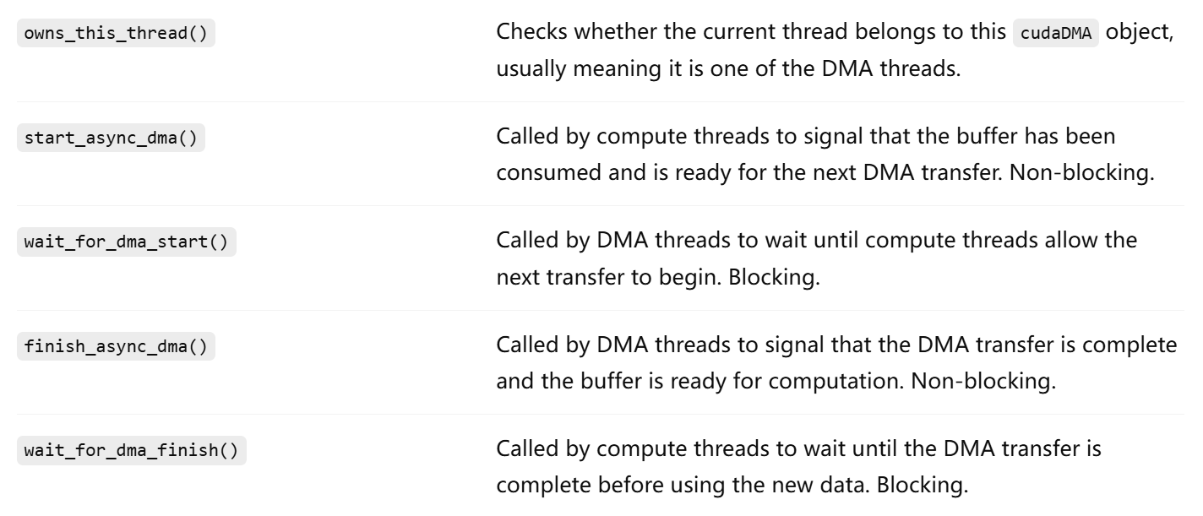
CUDADMA API

Slide 17
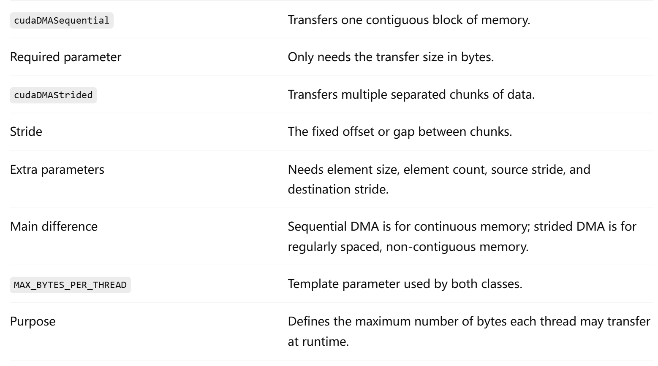
CUDADMA API

Slide 18

Transfer Pattern
Programmers don’t need to care
Common patterns can be written by expert: Programmablity & Performance
Leaves synchronization but unspecified transfer patterns

Slide 19
Streaming Computation
Specialization has overhead (Coordination)
Can be amortized streaming computation that iteratively transferring data
Multiple CTAs -> single CTA iteratively to make it streaming

Slide 20
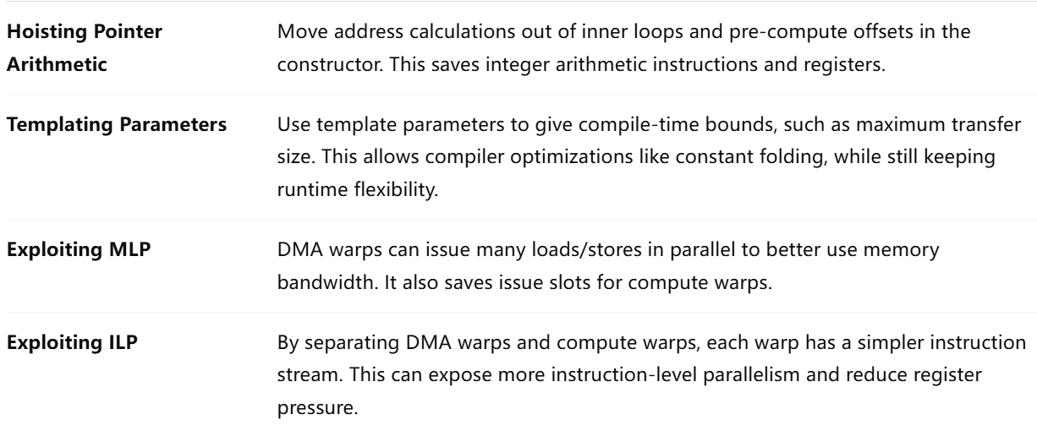
How Performance Enhanced
Warp specialization (About conserve resources):

Slide 21
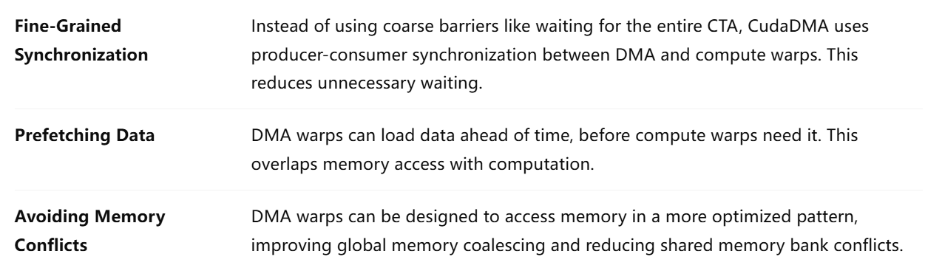
How Performance Enhanced
Warp specialization (About conserve resources):

Slide 22

How Performance Enhanced
Fine-Grained Synchronization (producer-consumer synchronization):
In CUDA:
All threads within a CTA must be synchronized.

Slide 23
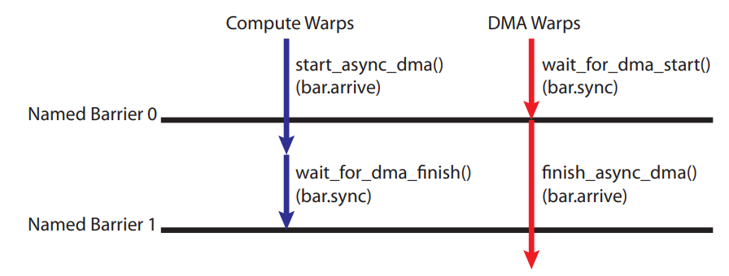
How Performance Enhanced
Fine-Grained Synchronization (producer-consumer synchronization):
two named barriers associated with every cudaDMA object

Slide 24
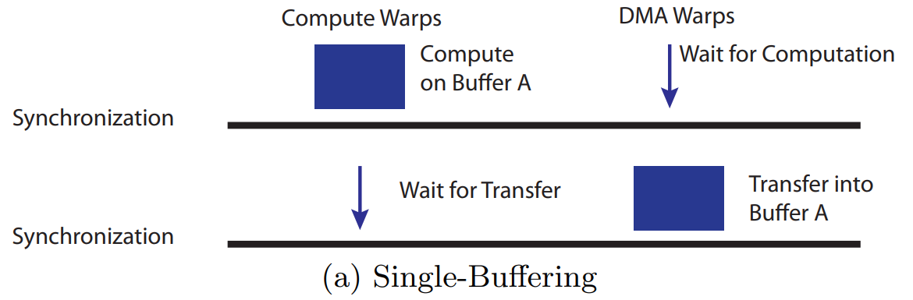
How Performance Enhanced
Buffering Techniques
Single Buffering: Each transfer is assigned with a shared memory buffer/cudaDMA
1: DMA warps fill the buffer
2: compute warps use the buffer
3: DMA warps fill it again
4: compute warps use it
Can work with Multiple CTAs on a single SM

Slide 25
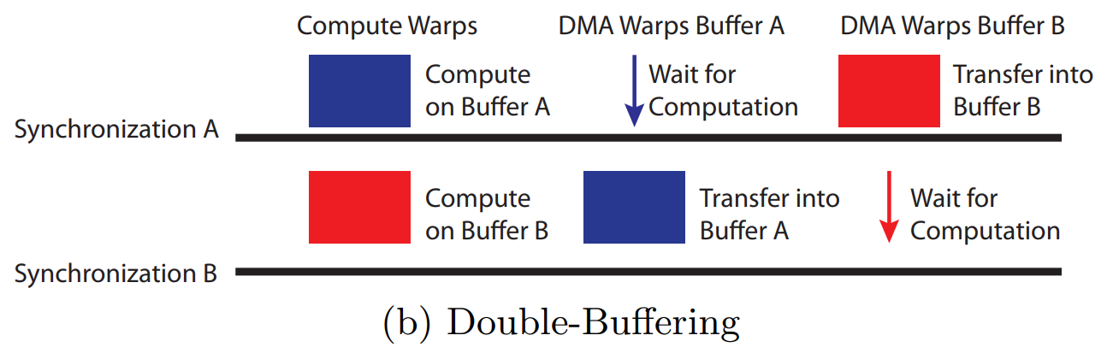
How Performance Enhanced
Buffering Techniques
Double Buffering:
2 buffers
2 CudaDMA objects
2 sets of DMA warps
1 set of compute warps
If register resources are limited
DMA warps are wasted

Slide 26
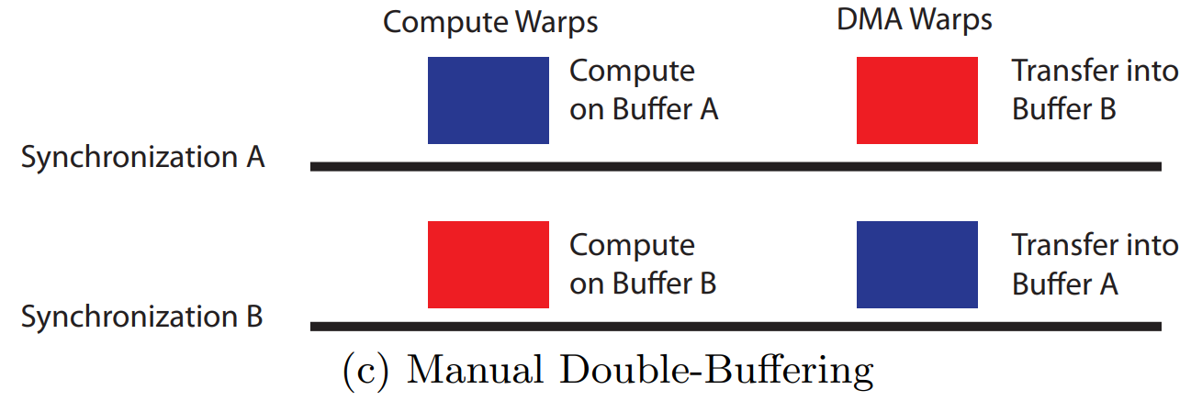
How Performance Enhanced
Buffering Techniques
Manual Double-Buffering:
2 buffers
2 CudaDMA objects
1 set of DMA warps shared
1 set of compute warps

Slide 27

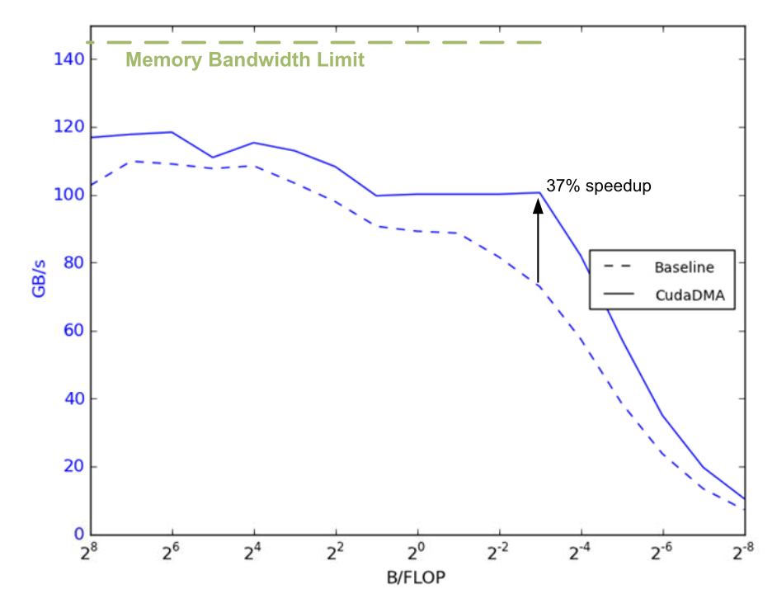
Results: Synthetic micro-benchmark
Baseline: 16 total warps, transfers 4 bytes per thread on each loop iteration
CudaDMA: +4 additional DMA wraps
Exploiting MLP

Slide 28
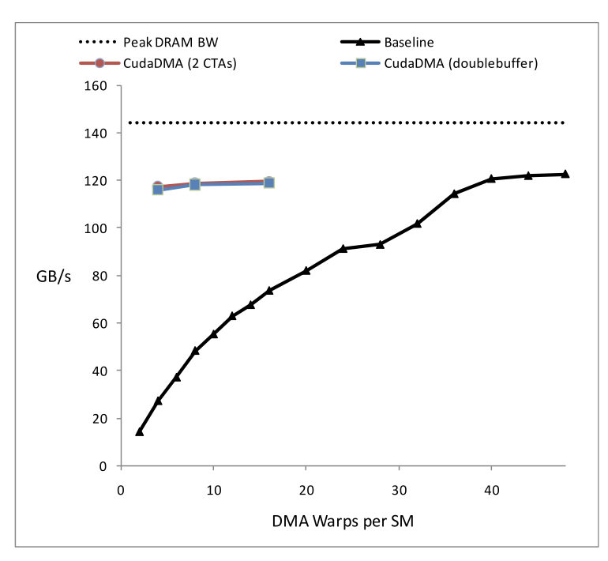
Results: Synthetic micro-benchmark
Single-precision a*x+y (saxpy) kernel with a ﬁxed B/FLOP ratio of 6
Baseline
Saturating memory bandwidth at low warp counts:
1. expose more MLP
2. More register-eﬃcien

Slide 29
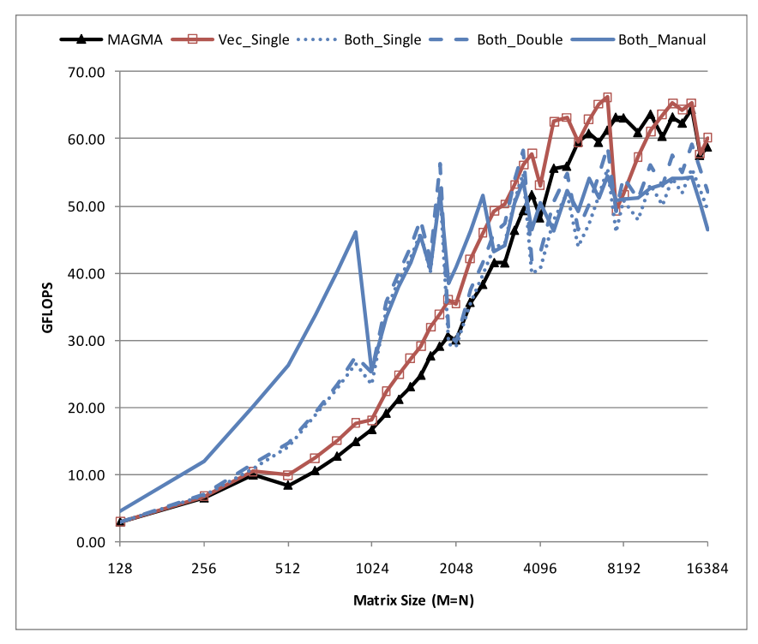
Results: Application kernels (SGEMV)
Only use CudaDMA on vector data
Single-precision GEneral Matrix-Vector multiplication
- small matrix size: MLP improves bandwidth
- large matrix size: vector implementation is beneficial
due to lower synchronization overhead

Slide 30
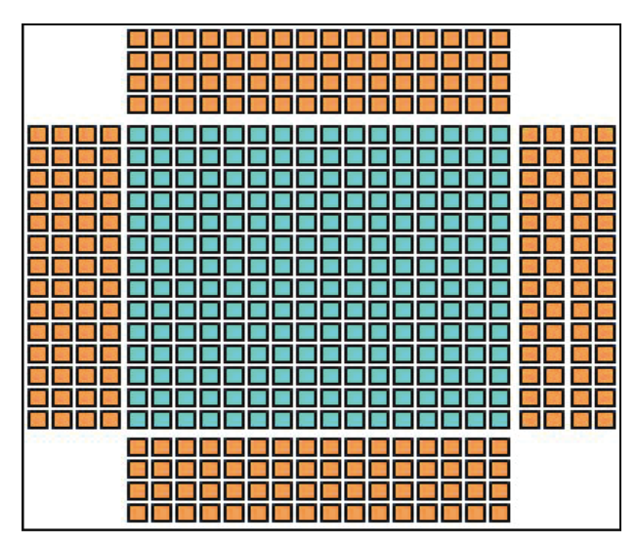
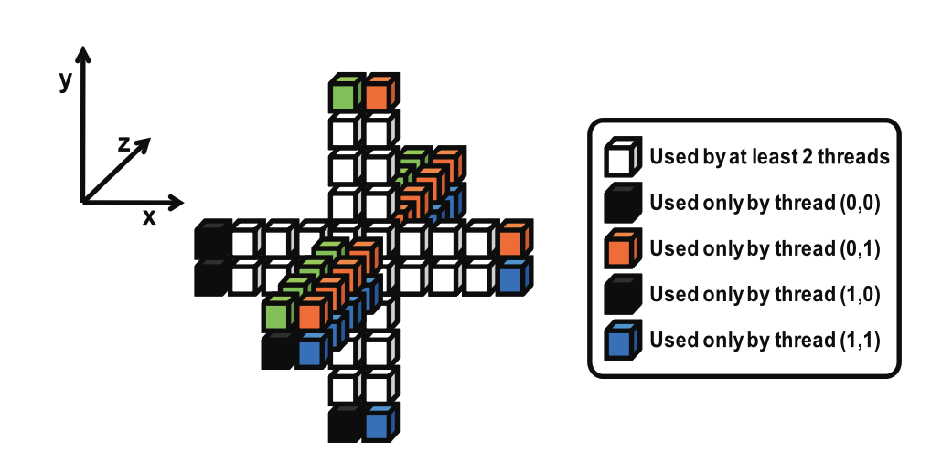
Results: Application kernels (3D FDM)
3D finite difference calculation:
- each CTA is assigned an X-Y slice
and walks through space along Z
- large number of cells are accessed
by threads in the same X-Y slice
Halo cells for 8’th order FDM

Slide 31
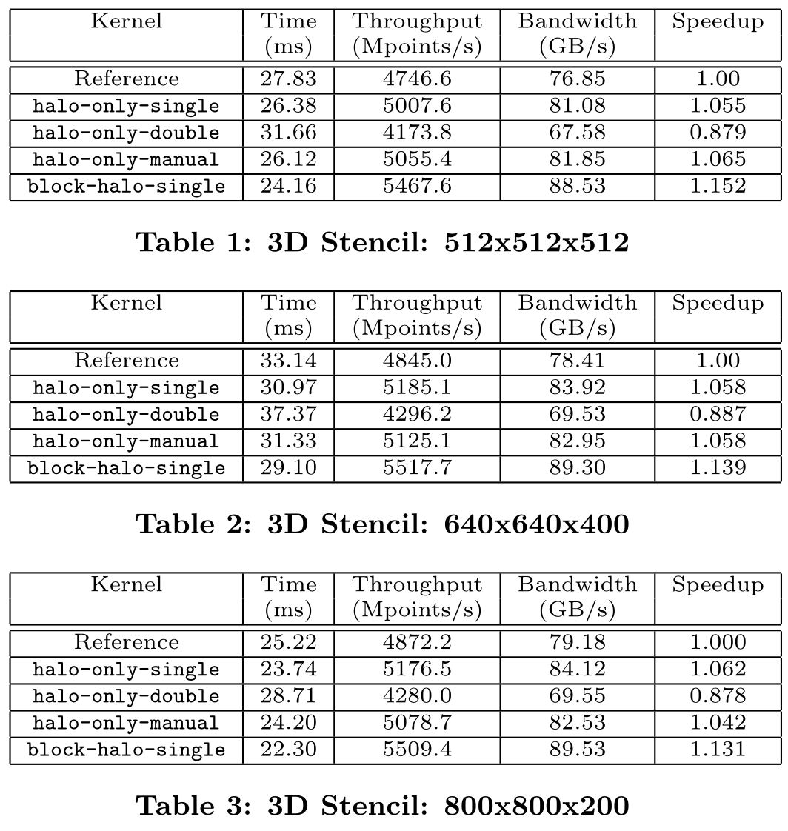
Results: Application kernels (3D FDM)
halo-only-*: load the halo cells within CudaDMA
block-halo-*: load the halo cells separately

Slide 32
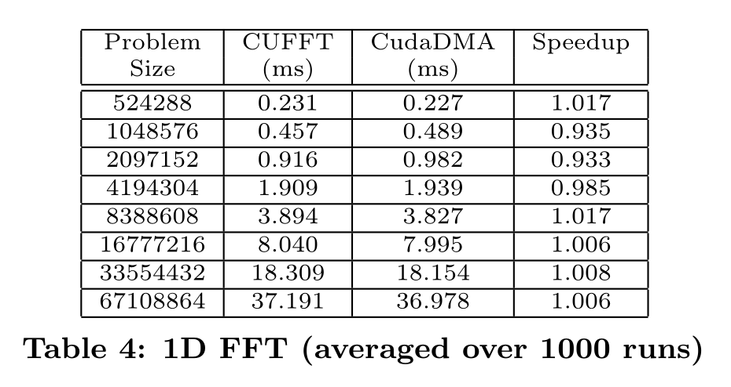
Results: Application kernels (1D FFT)
CuFFT is already saturating the memory bandwidth (w/ 32 wrap per SM),
But CudaDMA requires less wraps:
- 16 wraps per SM + 8 DMA wraps

Slide 33
Discussion
In modern GPU programming with an asynchronous memory copy paradigm,is
this “wrap specialization” concept still necessary?

Slide 34
Discussion
Does this approach scale to modern GPUs with more complex memory hierarchies?

